Slide 1
Image Multi-class Classification
Team 10 – Josh Pauly, Josue Perez Gomez

Slide 2
Computer Vision and Image Recognition
Computer Vision has been a field of study since the 1960's and in the 1970's foundations on identifying edges, corners, and applying gradients to images developed.
New applications such as object and face recognition became more popular as newer techniques and algorithms were created.
Now days computer vision is a very complete subject with many applications and with many tools that make it easy to work images and video.
Notes:
Josue: The field of computer vision dates back to the 1960s, back then it was believe that it could be possible for computer to see and describe what they saw. However it was during the 1970s when computer vision foundations where lay out. Such as identifying edges, and corners with algorithms as well as image transformation like rescaling and smoothing using gradient functions.
Later on new application began to come up such as facial and object recognition as new algorithms and more advance computational power became available.
Which brings us to today's age where the field of computer vision now makes a wide use of deep learning algorithms that allows for many more applications to be created and with a wide set of deep learning tools that make it easy to work images and video.

Slide 3






The Intel Image Recognition Competition Data Set
In 2018 there was an Intel Image Recognition challenge.
Task was to designing a solution to identify the classes an image belonged to.
Notes:
Joshua: In 2018 Intel Sponsored an image classification contest, of natural environments. The data set included around 25k images, 14k images to train from, 3k images to test and 7k images to predict with no labeling. These images are then subdivided in 6 folders for the training and testing dataset, 'buildings' -> 0, 'forest' -> 1, 'glacier' -> 2, 'mountain' -> 3, 'sea' -> 4, 'street' -> 5. The original contest saw over 3k participants, where the winner had an accuracy rate of 95%. With the images below we can even see why some humans might not have perfect accuracy rate identifying these images. For example, number 3 has a building in it, however the main focus is on the mountain. Number 0 has a street in the image, but is focused on one building. Number 2 and 4 it may be hard to tell the shades of blue apart. So in reality it is not so easy to identify these images over 6 categories. Having machines do the classification, might reduce error and time.
This data was initially published on https://datahack.analyticsvidhya.com by Intel to host a Image classification Challenge

Slide 4
Proposed Ideas and Challenges
Our idea was to make use of Deep Learning based models.
  Identify pros and cons of transfer learning models vs traditional CNNs
Some of the challenges included: Large and diverse dataset
  With large data sets it increases the run time of training the models.
  Having 6 categories could mean that when choosing a category for the image the model may not have a majority probability for one category for an image.
Help classify images in the future what the landscape the image is.
Notes:
Joshua: With this large dataset identifying images over six similar natural landscapes comes with challenges. Our idea is to utilize deep learning models to identify weaknesses and strengths of transfer learning and traditional CNNs. Challenges with a large data set is that with more data to train on the longer the run time will be as you have 14K images to train from. With a diverse category of images to predict, the model is not guaranteed to have a probability of over 50% for one category. This can lead to the prediction of one image to have a probability that is rather small. For example the image number 3 from the previous slide had a building in a mountain landscape. A model may have 45% probability of the image being a mountain, a 40% chance of it being a building, and because of the image color a 15% of the image being a forest. In this scenario we predict a Mountain but with low confidence.
In the future we would like to use our model to classify what landscape the image is of. For a photographer labeling images can save time in the future when choosing what image to use for a client. This reduces the time needed, as the photographer will not need to look through all previous images taken.

Slide 5
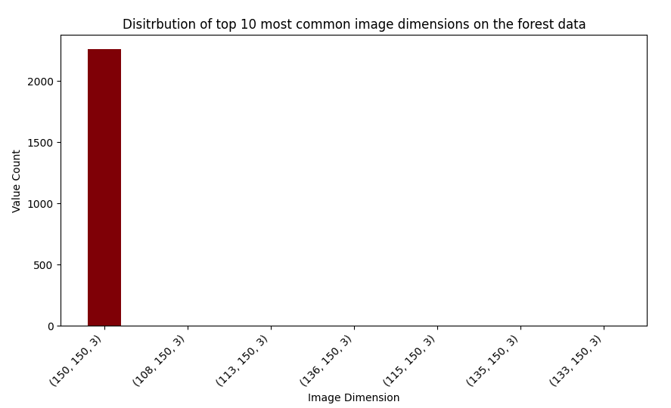
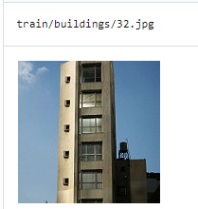
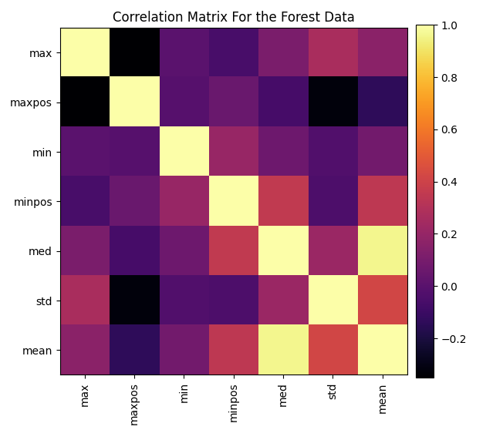
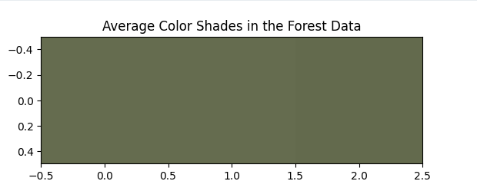
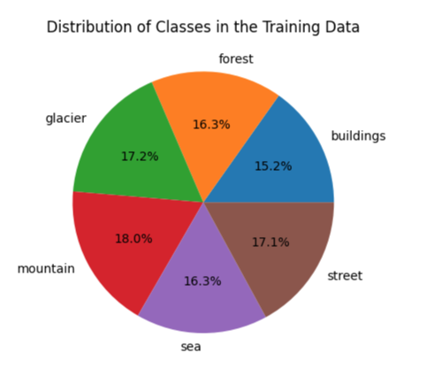
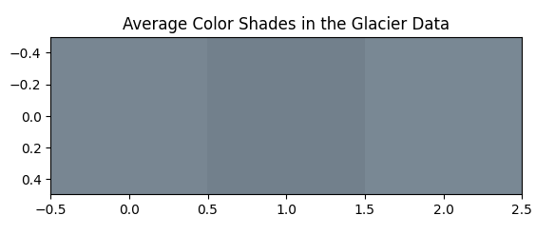
Data Exploration and Analysis
Our data exploration included: Image dimension analysis, correlation analysis, common color shade analysis, frequency analysis.
Computed a correlation matrix on statistical values for each class.
Computed the average color shades for each class of images.
Computed the frequency of images for each class. And plotted dimension frequency
Notes:
Josue:
As part of our data exploration and analysis we had to work with the images as 3-dimensional arrays that contained the pixel values for each channel on the image, that is a red, green and blue channel.
On the very left side you can see an original image of one of the buildings class image.
We then computed the max, argmax, min, argmin, median, standard deviation and mean values for all the images for each class and then created a correlation matrix to see if there was any correlation between the statical calculations. Though the only correlation that we found was that of the mean and median values, which is to be expected.
Additionally we calculated the average color share of the images for each class. This was calculated by using the KMeans algorithm to get the cluster centers on the normalized red, green and blue channels. The dominant colors were then calculated by multiplying the cluster center values times the standard deviation divided by 255 for each channel.
Then we also calculated the image frequency for each class as shown in the pie chart. Which did not show any signs of class skewness. And finally we calculated the frequency of all of the dimensions for the images for each class. To see if we had to resize images to normalize the data.

Slide 6
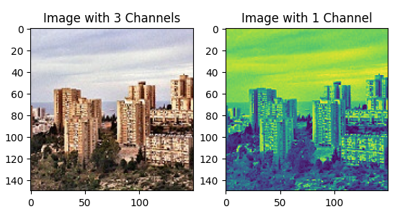
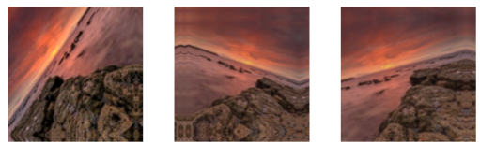
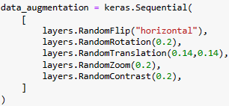
Data Manipulation
Dimensional reduction from 3 channels to 1 channel
Data augmentation
Image resizing
Notes:
Josue:
Some of the data manipulation techniques the we used before working with deep learning-based models was dimensional reduction. Specifically we did dimensionality reduction on the all of the data that is the training and test data. The original images when read into the Python compiler, they had a three channels each with a 2-dimensional matrix of about 150 by 150 pixels. So what we did was to reduce the three channels into a single channel with a single 2-dimensional matrix of 150 by 150. Essentially turning a color image into a black and white image. This manipulation allows for quicker training and allows us to use smaller convolutional layers, there by reducing the complexity of our model. However, as a consequence we lose information on the image, which can hurt the accuracy performance of the model.
Joshua: Data augmentation can be used to increase complexity in the data training set. Doing so will increase accuracy scores, as adding images helps the model not overfit if all the training set data is captured in a similar manner. In our dataset for the transfer learning model we used a horizontal flip, random rotation up to 20%, translation, a zoom, and a contrast. Doing these things allows the model to see unique images, and not focus on a particular pattern that may be misleading, and not represented in the test dataset.
Using an image size of 224 x 224 allows CNNs outputs feature maps of size 7x7. This is these CNN have learned to find certain patterns of certain sizes, so in transfer learning it helps to resize to what a model was previously trained on. In our case our transfer learning models such as VGG was trained on 224 x 224 images.

Slide 7
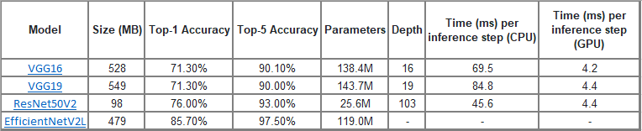
Solution(s)
Vanilla Convolutional Neural Network Architecture.
Convolutional Neural Network Architecture with Transfer Learning.
Notes:
Joshua: To test what is the best approach for image classification we split the work in two, testing a vanilla CNN network which had 4 Convolutional Layers, 4 Max Pooling layers, 1 flatten layer, 3 dense layers, 1 dropout layer. And CNNs from transfer learnings. Transfer learning solutions tested were VGG 16, VGG 19, Efficent net, and Resnet 50.

Slide 8
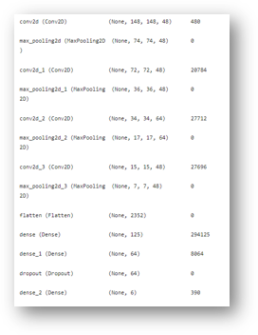
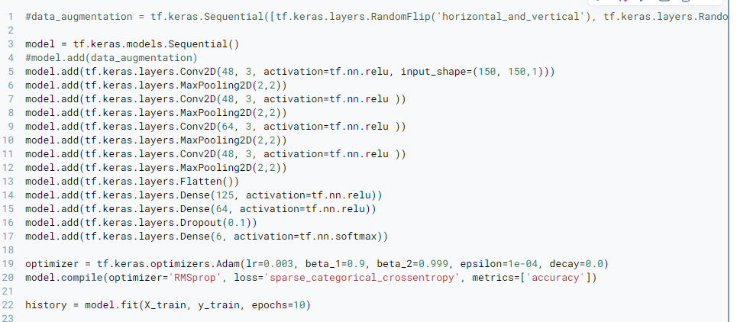
Vanilla CNN Model and Structure
4 Convolutional Layers, 4 Max Pooling layers, 1 flatten layer, 3 dense layers, 1 dropout layer.
10 epoch runs, Adam optimizer, 10% validation data.
ReLU activation functions, and softmax activation functions.
Sparse Categorical Cross-Entropy loss function.
RMSProp optimizer. Accuracy Metric.
Notes:
Josue:
For our vanilla convolutional neural network models we tested with different structures. Such as the number of convolutional layers, the size of the filters (such as 32, 48, and 64). As well as the number of pooling layers, the kind of pooling layers, such as a max pooling layer or a average pooling layer. Also the number of dense layers, the number of neurons on each layer, and its activation function.
Each convolutional layer had a kernel size of 48 except for one that had a kernel size of 64. All of their activation functions used a ReLU activation function to add non-linearity to the calculations. We only had to specify the input shape of the first convolutional layer so that it can take the shape of the images correctly.
We used Max Pooling layers with a pool size of (2,2) this layer does not need a activation function since it just computes the max pixel value of neighboring pixels.
Our dense layers had a size of 125, 64, and 6 neurons and each had a relu action function except for the last dense layer with size of 6, corresponding to the 6 possible types of class images, that had a softmax activation function.
Recall that the relu functions are great for adressing the vanishing gradient problem and introduction non-linearity to the model and it is simple and easy to use. While the softmax activation function works by creating a probabilistic vector distribution for each neuron in the layer. Which is great for classification problems.
Additionally we made use of a dropout layer. This dropout layer

Slide 9
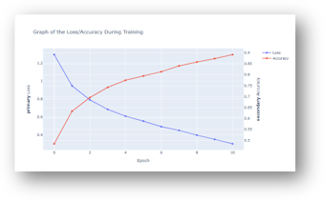
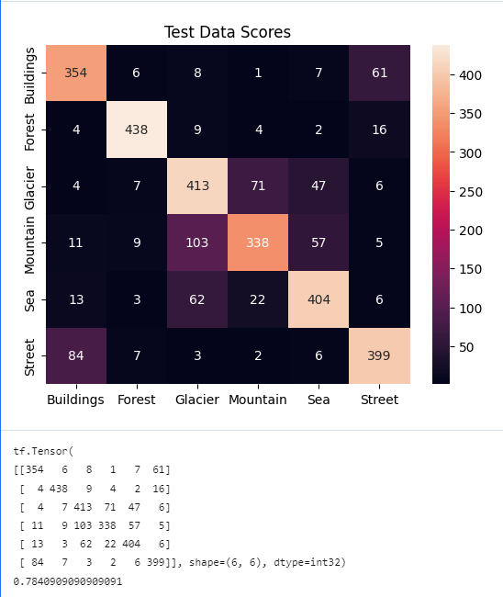
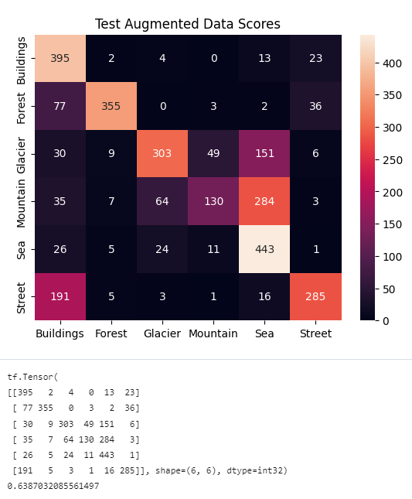
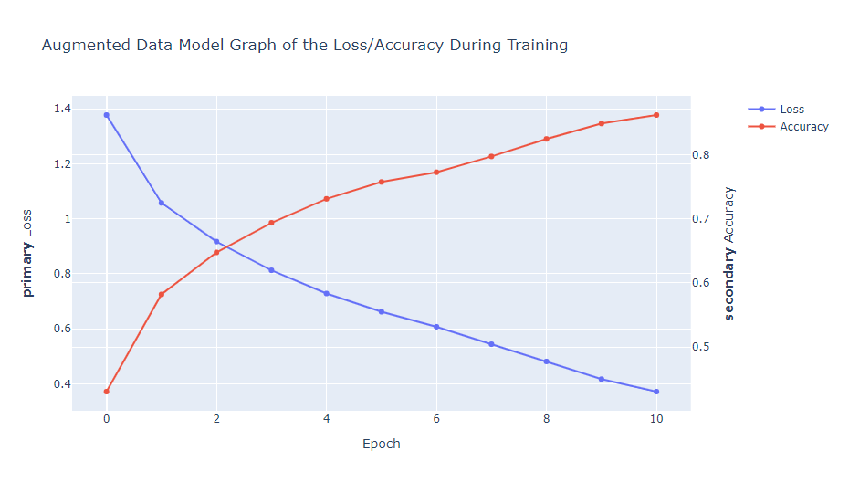
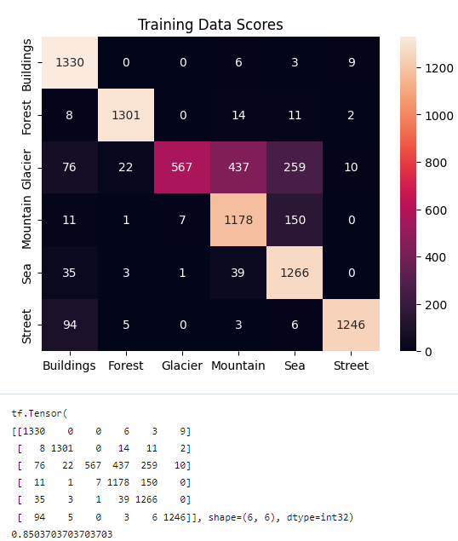
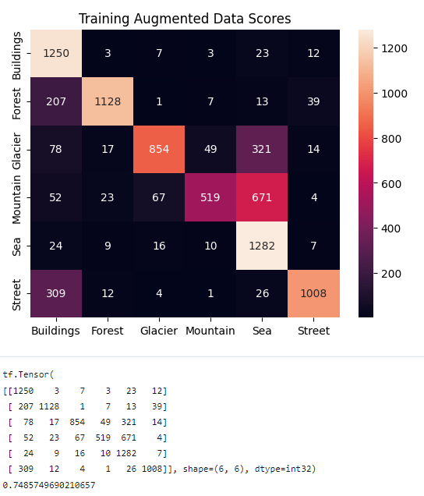
Vanilla CNN Results
Non-Augmented Data
Training Accuracy Score: 91%
Test Accuracy Score: 78.40%
Augmented Data
Training Accuracy Score: 85%
Test Accuracy Score: 68%
Notes:
Josue:
We split our results on the best two models. One model using regular 1 channel image data. And the other model using augmented 1 channel data.
From our non-augmented data scores, the training accuracy score was of about 91% while our test accuracy score was of 78.84%. And looking at the confusion matrix we could see that the model had trouble in distinguishing glacier images and mountain images. Which often mixed them up
For our model that used augmented data the scores were worse, the training score was of about 85% and our test accuracy score was of 68%. And looking at the confusion matrix we could see that the model also had the same trouble in distinguishing glacier images with mountain images.
We think this could be because the glaciers can have the same silhouette of a mountain.

Slide 10
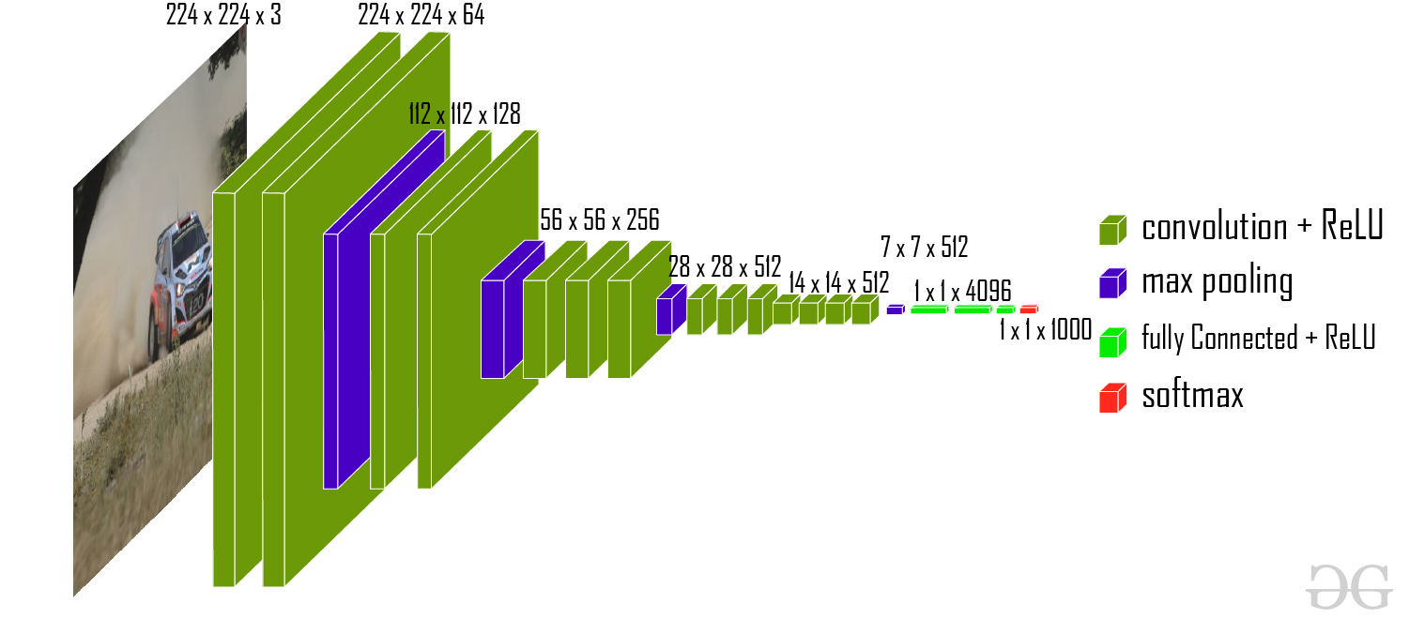
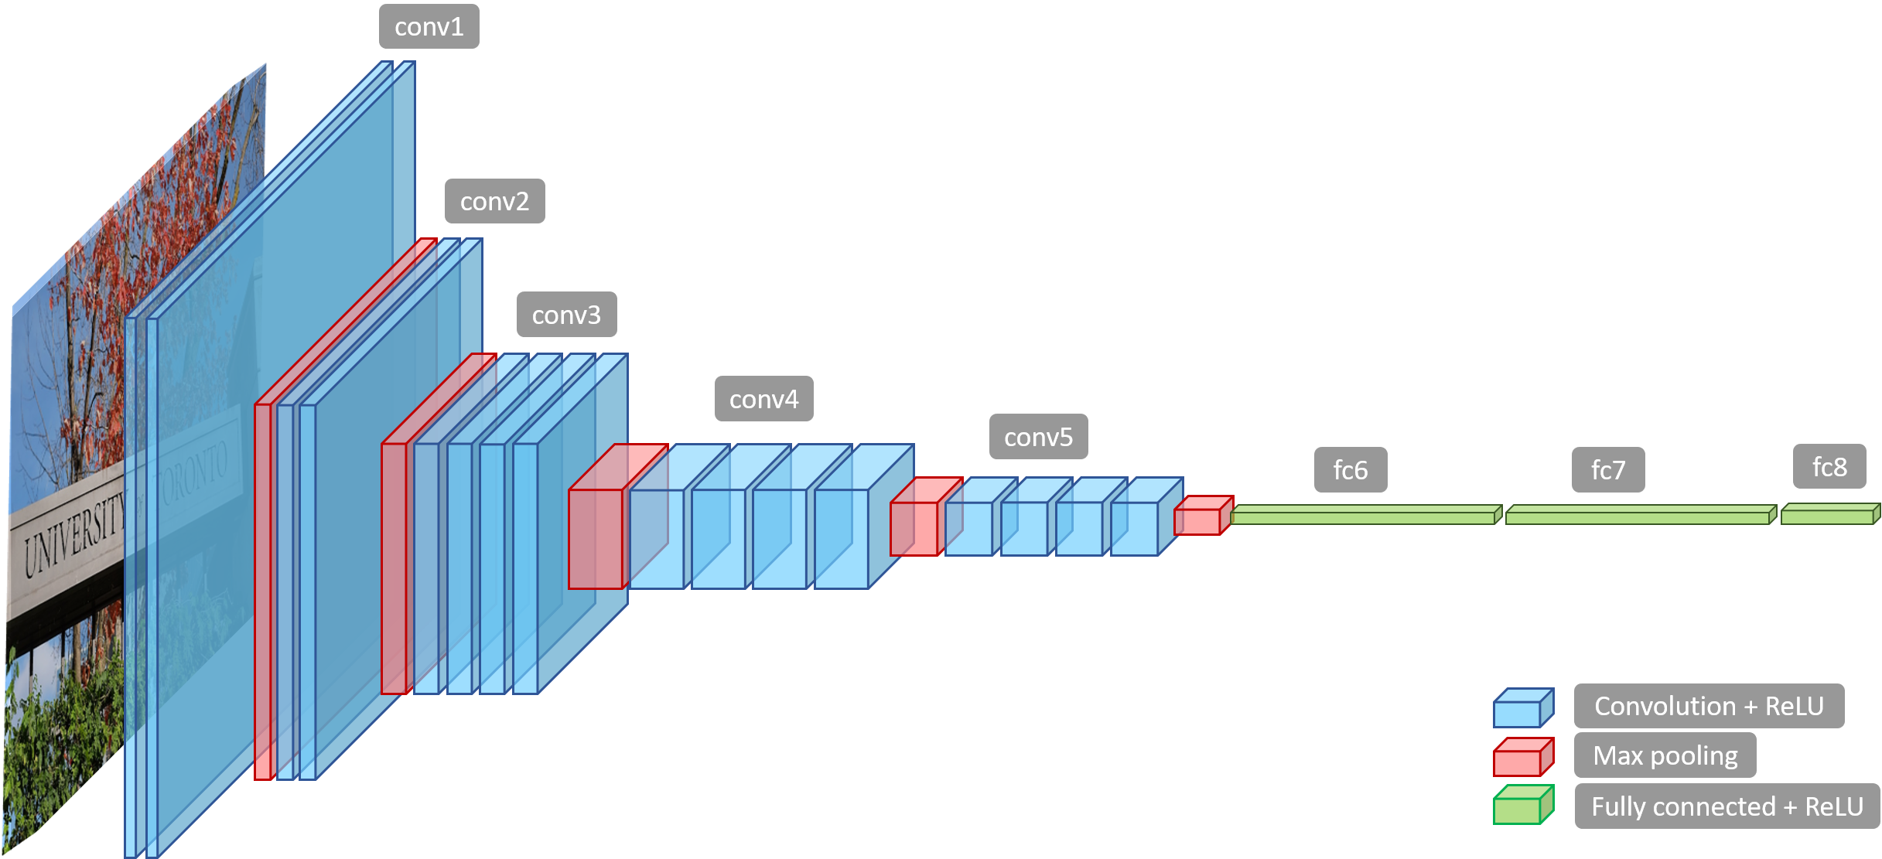
VGG 16 and 19 Transfer Learning Model
Notes:
Input—VGGNet receives a 224×224 image input. In the ImageNet competition, the model’s creators kept the image input size constant by cropping a 224×224 section from the center of each image.
Convolutional layers—the convolutional filters of VGG use the smallest possible receptive field of 3×3. VGG also uses a 1×1 convolution filter as the input’s linear transformation.
Hidden layers—all the VGG network’s hidden layers use ReLU.
Pooling layers–A pooling layer follows several convolutional layers—this helps reduce the dimensionality and the number of parameters of the feature maps created by each convolution step. Pooling is crucial given the rapid growth of the number of available filters from 64 to 128, 256, and eventually 512 in the final layers.
Fully connected layers—VGGNet includes three fully connected layers. The first two layers each have 4096 channels, and the third layer has 1000 channels, one for every class

Slide 11
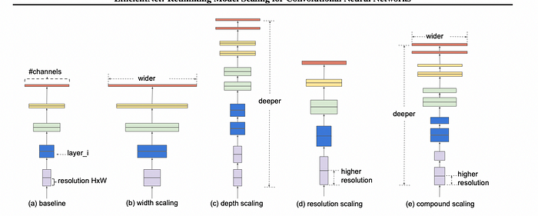
EfficentNet Transfer Learning Model
Notes:
Josh : EfficientNet is a convolutional neural network that is based on the notion of "compound scaling." Compound scaling is intended to scale three critical aspects of a neural network: breadth, depth, and resolution.
Width: The number of channels in each layer of the neural network is referred to as width scaling. By enlarging the width, the model may capture more complicated patterns and characteristics, resulting in higher accuracy. Reducing the width, on the other hand, results in a more lightweight AI model that is ideal for low-resource applications.
Depth: The total number of layers in the network is referred to as depth scaling. Deeper models can capture more complex data representations, but they also need more computing resources. Shallower models, on the other hand, are more computationally efficient but may forfeit accuracy.
Resolution: Resolution scaling entails changing the size of the input image. Higher-resolution images give more detailed information, which may result in improved performance. They do, however, need larger memory and processing power. Lower-resolution images, on the other hand, use fewer resources but may lose fine-grained information.

Slide 12
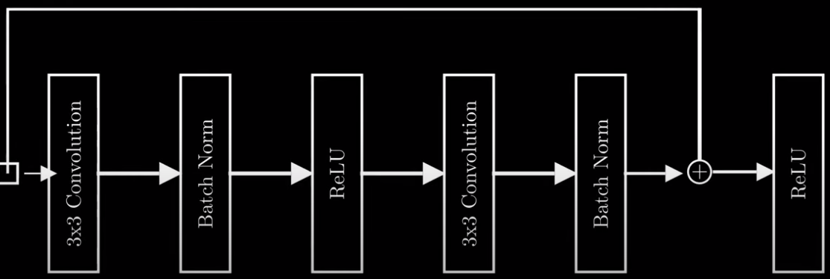
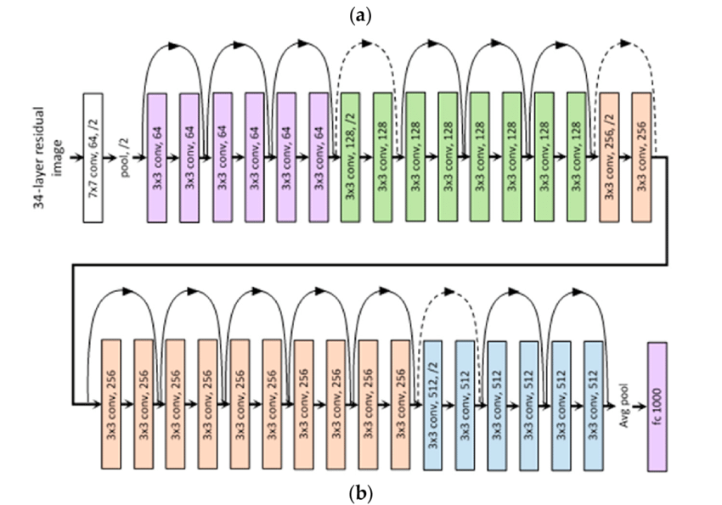
ResNet 50 Transfer Learning Model
Residual block
Notes:
Josh: Resnet 50 arcetectures is one of the most popular used models. This network incoperates residual connections all along the network to save training signal from being lost in the model. Because of this we can view layers as residual blocks instead of individual layers. The residual blocks can produce identity function this allows the ability to train really deep networks as the loss function is reduced.
In the images the first one is a drawing of a residual block where the input can be produced in the output. In the second picture we can see a serries of these residual blocks. The color change is indicates the image dimensionality reduction which is done every couple of blocks or so. n

Slide 13
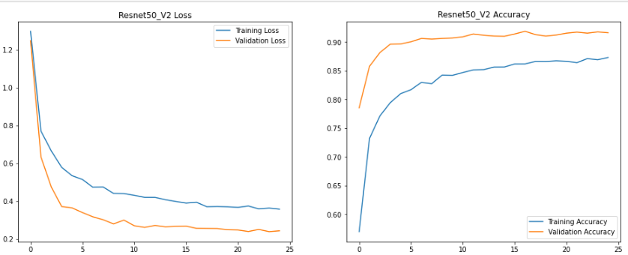
Transfer Learning CNN Results
Originally with 128 batch size Adam optimizer and 15 epochs all 4 networks produced similar results 90.6%
Resnet 50 had the quickest run time
Best result was 512 batch size 25 epochs 91.1% accuracy
Notes:
Joshua:

Slide 14
Pros and Cons
Vanilla CNN
  Pros: Shorter training runtime.
  Cons: Less accurate predictions.
Transfer Learning based CNN
  Pros: More accurate predictions.
  Cons: Longer training runtime.
Notes:
Josue: The pros of using Vanilla CNNs were the shorter time it took to train our models. For instance the model that had the best accuracy score only took about 2 hours to train. And that model had a test accuracy score of 78.58%, which while not great this is a relatively decent accuracy nonetheless. Which bring us to the cons of a vanilla CNN. And that is less accurate predictions. This approach requires a large amount of fine tunning and preprocessing to get a decent or good score for large datasets.
Joshua: The pros of using Transfer learning based CNNs was higher accuracy, and the ability to test pre made architectures. The con was the run time with so many adjustable variables even Resnet 50 took 3 hours to run 15 Epochs.

Slide 15
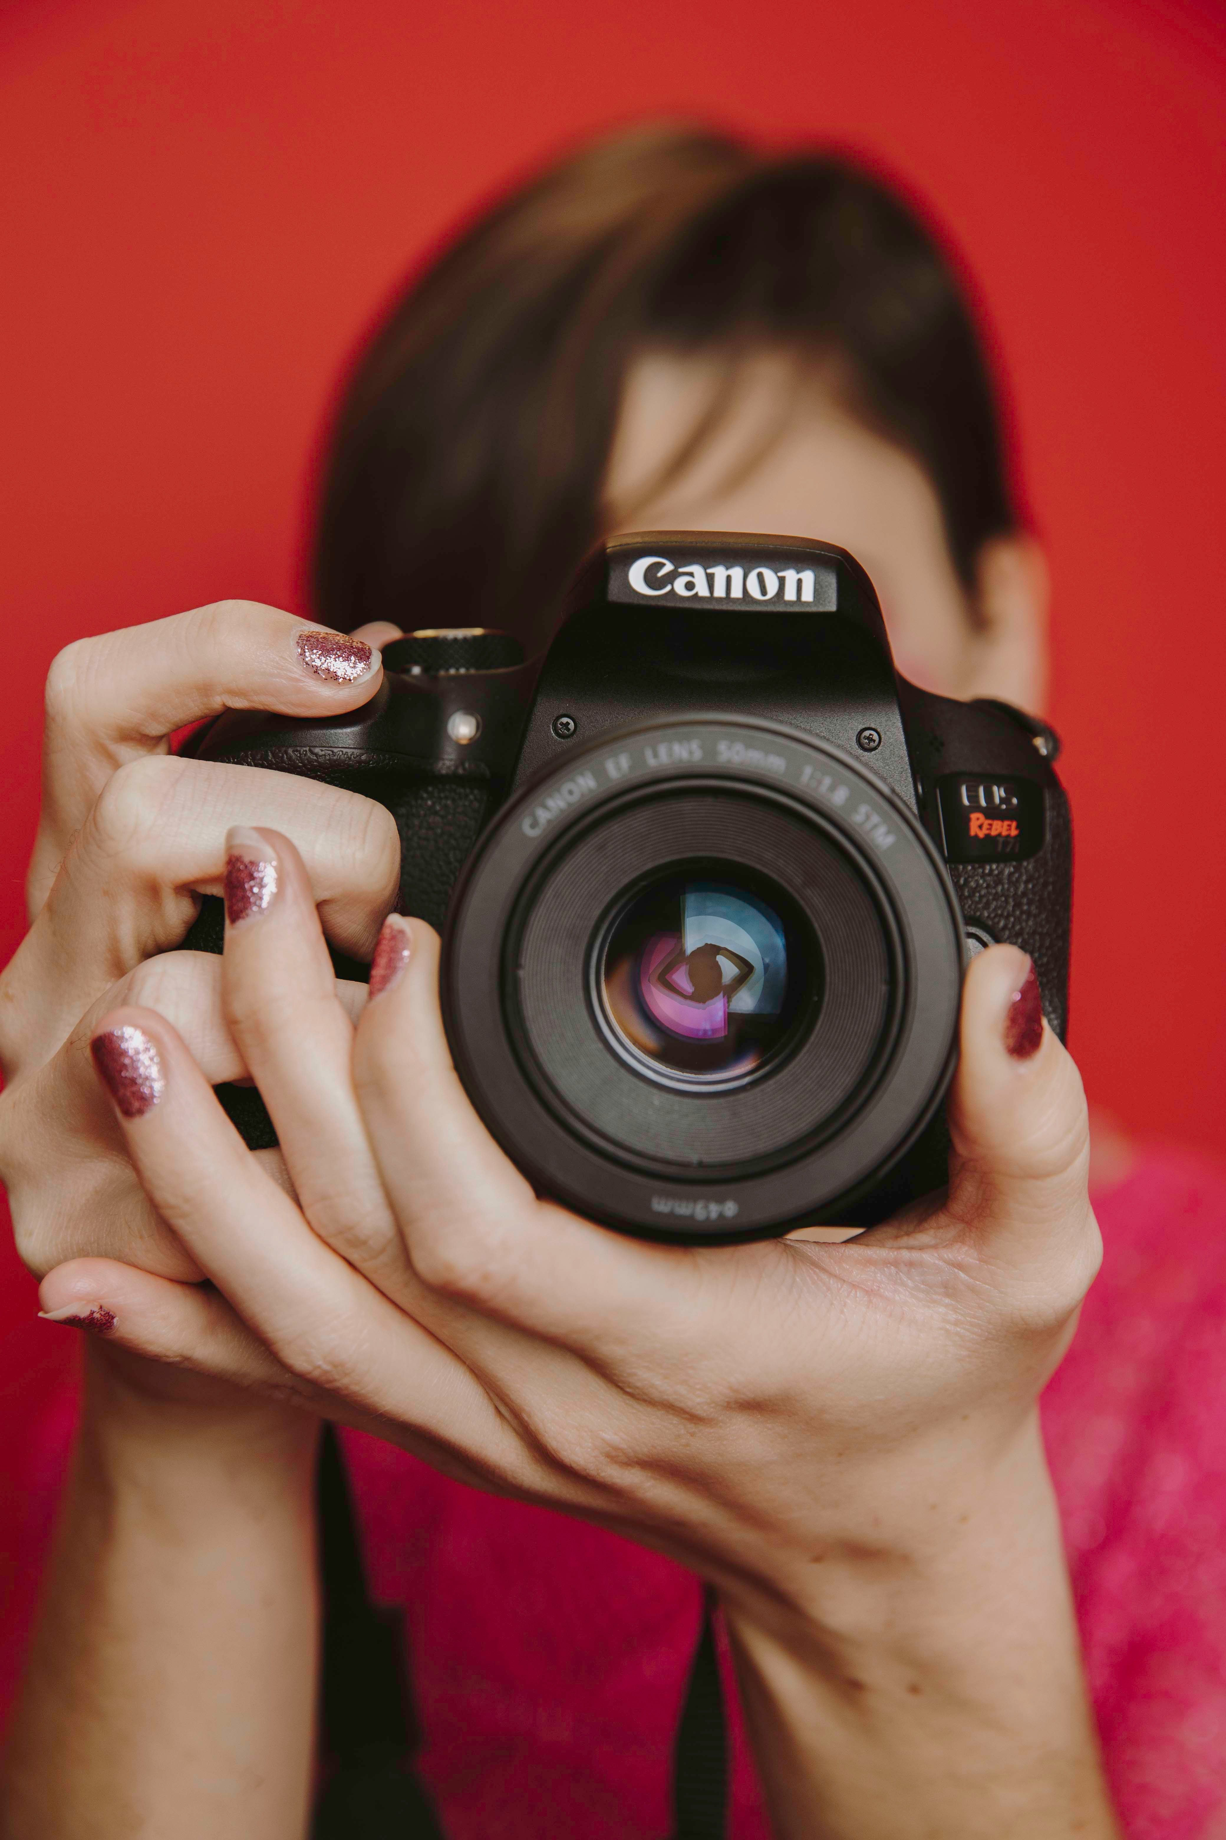


Future Work
Incorporate the models into a software that sort images into folders for photographers and consumers.
Making our models better at predicting pictures that we ourselves can take in the real world and test.
Think of variation of the idea of image sorting and filter based on their scenery.
Notes:
Joshua: In the future we would like to implement our model for consumers to have photos of landscapes pre sorted into folders. To make our model higher accuracy we would like to incorporate an ensemble approach where we can have multiple models vote on top solutions. If one model has highish probabilities for two categories maybe it could defer to a second model only trained on those two categories which would have a higher accuracy rate for those two landscapes. Ensemble methods seem to produce the highest accuracy as it relies on multiple models.

Slide 16
Thank You!

